Slide 1
Data 100 Lecture 4: Data Cleaning & Exploratory Data Analysis
?
Slides by:
Joseph E. Gonzalez, Deb Nolan, & Joe Hellerstein
jegonzal@berkeley.edu
deborah_nolan@berkeley.edu
hellerstein@berkeley.edu

Slide 2
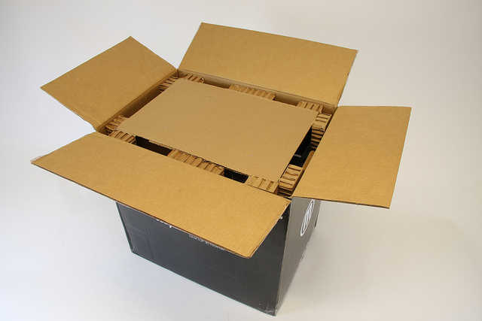
Congratulations!
You have collected or been given a box of data?
What do you do next?
Box of Data

Slide 3
Question & Problem Formulation
?
Data Acquisition
Prediction and Inference
Exploratory Data Analysis

Slide 4
Question & Problem Formulation
?
Topics For Lecture Today
Data Acquisition
Understanding the Data
Data Cleaning and Exploratory Data Analysis
Basic data visualization
Common Data Anomalies
… and how to fix them
Prediction and Inference
Exploratory Data Analysis

Slide 5
Data Cleaning
Exploratory Data
Analysis
… the infinite loop of data science.

Slide 6
Data Cleaning
The process of transforming raw data to facilitate subsequent analysis
Data cleaning often addresses
structure / formatting
Missing or corrupted values
Units
Encoding text as numbers
…
Sadly data cleaning is a big part of data science…

Slide 7
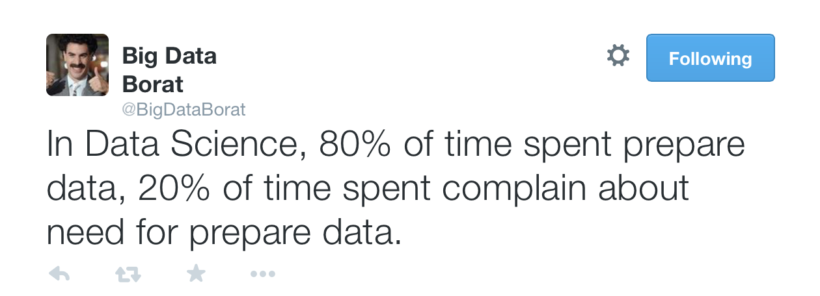
Another Statistic …

Slide 8
Exploratory Data Analysis
(EDA)
“Getting to know the data”
A process of transforming, visualizing, and summarizing data to:
Build/confirm understanding of the data and its provenance
Identify and address potential issues in the data
Inform the subsequent analysis
discover potential hypothesis … (be careful)
EDA is an open ended analysis
Be willing to find something surprising

Slide 9

John Tukey
Princeton Mathematician & Statistician
Introduced
Fast Fourier Transform
Exploratory Data Analysis
“Bit” : binary digit
Early Data Scientist
Data Analysis & Statistics, Tukey 1965
Image from LIFE Magazine
Notes:
John Tukey, Princeton mathematician and statistician, inventor of the Fast Fourier Transform and father of Exploratory Data Analysis. Also coined the word “bit”.
Emphasis courtesy Jeff Heer, U. Washington

Slide 10
EDA is like detective work
“Exploratory data analysis is an attitude, a state of flexibility, a willingness to look for those things that we believe are not there, as well as those that we believe to be there.”
Data Analysis & Statistics, Tukey 1965
Image from LIFE Magazine
Notes:
Contrast to confirmatory data analysis (statistical hypothesis testing)

Slide 11
What should we look for?

Slide 12
Key Data Properties to Consider in EDA
Structure -- the “shape” of a data file
Granularity -- how fine/coarse is each datum
Scope -- how (in)complete is the data
Temporality -- how is the data situated in time
Faithfulness -- how well does the data capture “reality”

Slide 13
Key Data Properties to Consider in EDA
Structure -- the “shape” of a data file
Granularity -- how fine/coarse is each datum
Scope -- how (in)complete is the data
Temporality -- how is the data situated in time
Faithfulness -- how well does the data capture “reality”

Slide 14
Rectangular Data
Fields/Attributes/ Features/Columns
We prefer rectangular data for data analysis (why?)
Regular structures are easy manipulate and analyze
A big part of data cleaning is about transforming data to be more rectangular
Two kinds of rectangular data: Tables and Matrices
(what are the differences?)
Tables (a.k.a. data-frames in R/Python and relations in SQL)
Named columns with different types
Manipulated using data transformation languages (map, filter, group by, join, …)
Matrices
Numeric data of the same type
Manipulated using linear algebra
Records/Rows

Slide 15
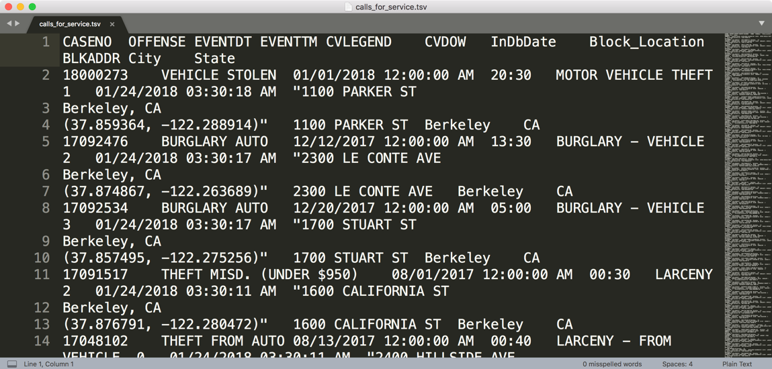
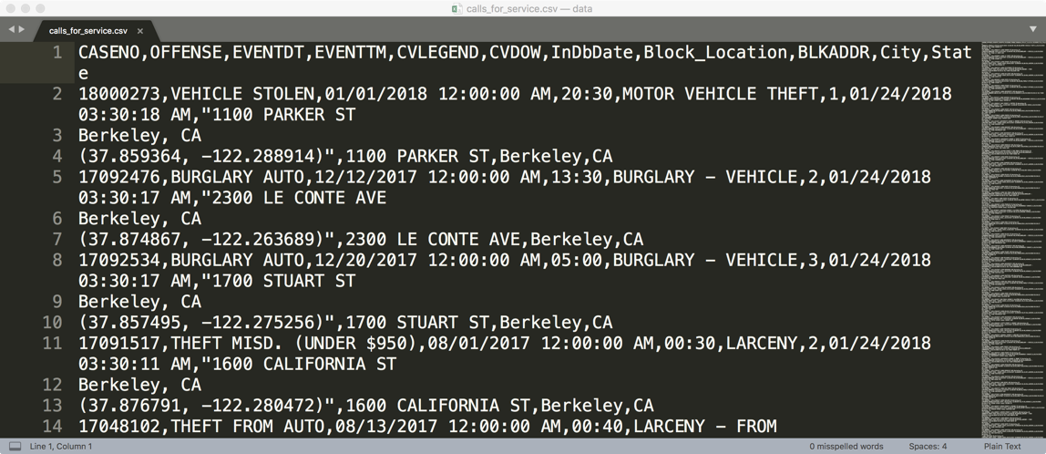
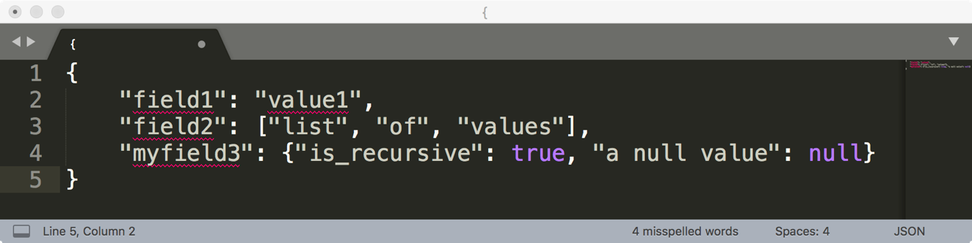
How are these data files formatted?
Which is the best?
TSV
CSV
JSON

Slide 16
Comma and Tab Separated Values Files
Tabular data where
records are delimited by a newline: ‘\n’, “\r\n”
Fields are delimited by ‘,’ (comma) or ‘\t’ (tab)
Very Common!
Issues?
Commas, tabs in records
Quoting
…

Slide 17
JavaScript Object Notation (JSON)
Widely used file format for nested data and the web
Natural maps to python dictionaries (many tools for loading)
Strict formatting ”quoting” addresses some issues in CSV/TSV
Issues
Each record can have different fields
Nesting means records can contain records → complicated

Slide 18
XML Data
<catalog>
<plant type='a'>
<common>Bloodroot</common>
<botanical>Sanguinaria canadensis</botanical>
<zone>4</zone>
<light>Mostly Shady</light>
<price>2.44</price>
<availability>03/15/2006</availability>
<description>
<color>white</color>
<petals>true</petals>
</description>
<indoor>true</indoor>
</plant>
…
</catalog>
Nested structure
We will study XML later in the class
Notes:
anything in brackets is markup; only 4 pieces of information

Slide 19
Real data -- Web log
Is this a csv file? tsv?
JSON/XML?
169.237.46.168 - - [26/Jan/2014:10:47:58 -0800] "GET /stat141/Winter04 HTTP/1.1" 301 328 "http://anson.ucdavis.edu/courses/" "Mozilla/4.0 (compatible; MSIE 6.0; Windows NT 5.0; .NET CLR 1.1.4322)”
169.237.6.168 - - [8/Jan/2014:10:47:58 -0800] "GET /stat141/Winter04/ HTTP/1.1" 200 2585 "http://anson.ucdavis.edu/courses/" "Mozilla/4.0 (compatible; MSIE 6.0; Windows NT 5.0; .NET CLR 1.1.4322)"

Slide 20
Questions to ask about Structure
Is the data in a standard format or encoding?
Tabular data: CSV, TSV, Excel, SQL
Nested data: JSON or XML
Is the data organized in “records”?
Yes: How are the records organized?
No: (e.g., raw dialogue) Can we define records (e.g., conversations).
Is the data nested? (Records contained within records…)
Yes: Can we reasonably un-nest the data?
What are the fields in each record?
How are they encoded? (e.g., strings, numbers, binary, dates …)
Do all the records in the dataset contain the same fields?
No: Are values missing or are there different types of data?
What is the type of the data?

Slide 21
Kinds of
Data
Note that data categorical data can also be numbers and quantitative data may be stored as strings.
Categorical Data
Quantitative Data
Numbers with meaning ratios or intervals.
Ordinal
Nominal
Examples:
Price
Quantity
Temperature
Date
…
Categories with orders but no consistent meaning if magnitudes or intervals
Categories with no
specific ordering.
Examples:
Preferences
Level of education
…
Examples:
Political Affiliation
CalD number
…

Slide 22
Structure: Field Types
Quantitative Data: data with meaningful differences or ratios
Continuous: weight, temperature, volume
Discrete: counts, …
Visualization: histograms and box plots
Ordinal Data: data where relative order matters
Differences between entries may not be the same
Examples:
level of education: [BS, MS, PhD]
Preferences: [Dislike, Like, Must Have]
Visualization: Bar charts (sorted)
Nominal Data: data with no numerical meaning
Examples: names, political affiliation, eye color,
It may be encoded as numbers …
Visualization: Bar charts

Slide 23
Field Types:
Price in dollars of a product?
(A) Quantitative, (B) Ordinal, (C) Nominal
Cal ID Numbers?
(A) Quantitative, (B) Ordinal, (C) Nominal
Star Rating on Yelp?
(A) Quantitative, (B) Ordinal, (C) Nominal
Date an item was sold?
(A) Quantitative, (B) Ordinal, (C) Nominal
Notes:
A, C (maybe ordinal?), B (sometimes treated as quantitative), A

Slide 24
Structure: Keys
Purchases.csv
OrderNum | ProdID | Quantity
1 | 42 | 3
1 | 999 | 2
2 | 42 | 1
Often data will reference other pieces of data
Primary key: the column or set of columns in a table that determine the values of the remaining columns
Primary keys are unique
Examples: SSN, ProductIDs, …
Foreign keys: the column or sets of columns that reference primary keys in other tables.
Foreign Key
Orders.csv
OrderNum | CustID | Date
1 | 171345 | 8/21/2017
2 | 281139 | 8/30/2017
Products.csv
ProdID | Cost
42 | 3.14
999 | 2.72
Primary Key
Customers.csv
CustID | Addr
171345 | Harmon..
281139 | Main ..

Slide 25
Key Data Properties to Consider in EDA
Structure -- the “shape” of a data file
Granularity -- how fine/coarse is each datum
Scope -- how (in)complete is the data
Temporality -- how is the data situated in time
Faithfulness -- how well does the data capture “reality”

Slide 26
Key Data Properties to Consider in EDA
Structure -- the “shape” of a data file
Granularity -- how fine/coarse is each datum
Scope -- how (in)complete is the data
Temporality -- how is the data situated in time
Faithfulness -- how well does the data capture “reality”

Slide 27
Granularity
What does each record represent?
Examples: a purchase, a person, a group of users
Do all records capture granularity at the same level?
Some data will include summaries as records
If the data are coarse how was it aggregated?
Sampling, averaging, …
What kinds of aggregation is possible/desirable?
From individual people to demographic groups?
From individual events to totals across time or regions?
Hierarchies (city/county/state, second/minute/hour/days)
Understanding and manipulating granularity can help reveal patterns.

Slide 28
Granularity and Keys
Purchases.csv
OrderNum | ProdID | Quantity
1 | 42 | 3
1 | 999 | 2
2 | 42 | 1
The primary key defines what the record represents → Granularity
What is the granularity of these example tables?
Purchases.csv: PK=(OrderNum + ProdID) ➔ Each Item in an order
Orders.csv: PK = OrderNum → an order
How might we adjust the granularity?
Aggregation: count, mean, median, var, groupby, pivot …
Orders.csv
OrderNum | CustID | Date
1 | 171345 | 8/21/2017
2 | 281139 | 8/30/2017
Products.csv
ProdID | Cost
42 | 3.14
999 | 2.72
Customers.csv
CustID | Addr
171345 | Harmon..
281139 | Main ..

Slide 29
Key Data Properties to Consider in EDA
Structure -- the “shape” of a data file
Granularity -- how fine/coarse is each datum
Scope -- how (in)complete is the data
Temporality -- how is the data situated in time
Faithfulness -- how well does the data capture “reality”

Slide 30
Key Data Properties to Consider in EDA
Structure -- the “shape” of a data file
Granularity -- how fine/coarse is each datum
Scope -- how (in)complete is the data
Temporality -- how is the data situated in time
Faithfulness -- how well does the data capture “reality”

Slide 31
Scope
Does my data cover my area of interest?
Example: I am interested in studying crime in California but I only have Berkeley crime data.
Is my data too expansive?
Example: I am interested in student grades for DS100 but have student grades for all statistics classes.
Solution: Filtering → Implications on sample?
If the data is a sample I may have poor coverage after filtering …
Does my data cover the right time frame?
More on this in temporality …

Slide 32
Key Data Properties to Consider in EDA
Structure -- the “shape” of a data file
Granularity -- how fine/coarse is each datum
Scope -- how (in)complete is the data
Temporality -- how is the data situated in time
Faithfulness -- how well does the data capture “reality”

Slide 33
Key Data Properties to Consider in EDA
Structure -- the “shape” of a data file
Granularity -- how fine/coarse is each datum
Scope -- how (in)complete is the data
Temporality -- how is the data situated in time
Faithfulness -- how well does the data capture “reality”

Slide 34
Temporality
What is the meaning of a the time and date fields?
When the “event” happened?
When the data was collected or was entered into the system?
Time depends on where? (Time zones & daylight savings)
Learn to use datetime python library
Multiple string representation (depends on region): 08/08/08?
Are there strange null values?
January 1st 1970, January 1st 1900
Date the data was copied into a database (look for many matching timestamps)
Is there periodicity? Diurnal patterns

Slide 35
Key Data Properties to Consider in EDA
Structure -- the “shape” of a data file
Granularity -- how fine/coarse is each datum
Scope -- how (in)complete is the data
Temporality -- how is the data situated in time
Faithfulness -- how well does the data capture “reality”

Slide 36
Key Data Properties to Consider in EDA
Structure -- the “shape” of a data file
Granularity -- how fine/coarse is each datum
Scope -- how (in)complete is the data
Temporality -- how is the data situated in time
Faithfulness -- how well does the data capture “reality”

Slide 37
Faithfulness: Do I trust this data?
Does my data contain unrealistic or “incorrect” values?
Examples?
Dates in the future for events in the past
Locations that don’t exist
Negative counts
Misspellings of names
Large outliers
Does my data violate obvious dependencies?
E.g., age and birthday don’t match
Was the data entered by hand?
Spelling errors, fields shifted …
Did the form require fields or provide default values?
Are there obvious signs of curb stoning (data falsification):
Repeated names, fake looking email addresses, repeated use of uncommon names or fields.

Slide 38
Signs that your data may not be faithful
Missing Values/Default values: (0, -1, 999, 12345, NaN, Null, 1970, 1900, … others?)
Soln 1: Drop records with missing values → implications on your sample!
Soln 2: Impute missing values → Bias your conclusions
Time Zone Inconsistencies
Soln 1: convert to a common timezone (e.g., UTC)
Soln 2: convert to the timezone of the location – useful in modeling behavior.
Duplicated Records or Fields
Soln: identify and eliminate (use primary key) → implications on sample?
Spelling Errors
Soln: Apply corrections or drop records not in a dictionary → implications on sample?
Units not specified or consistent
Solns: Infer units, check values are in reasonable ranges for data
Truncated data (early excel limits: 65536 Rows, 255 Columns)
Soln: be aware of consequences in analysis → how did truncation affect sample?
Others…
Notes:
Negative numbers, large outliers, failed parsing …

Slide 39

Quick Break

Slide 40
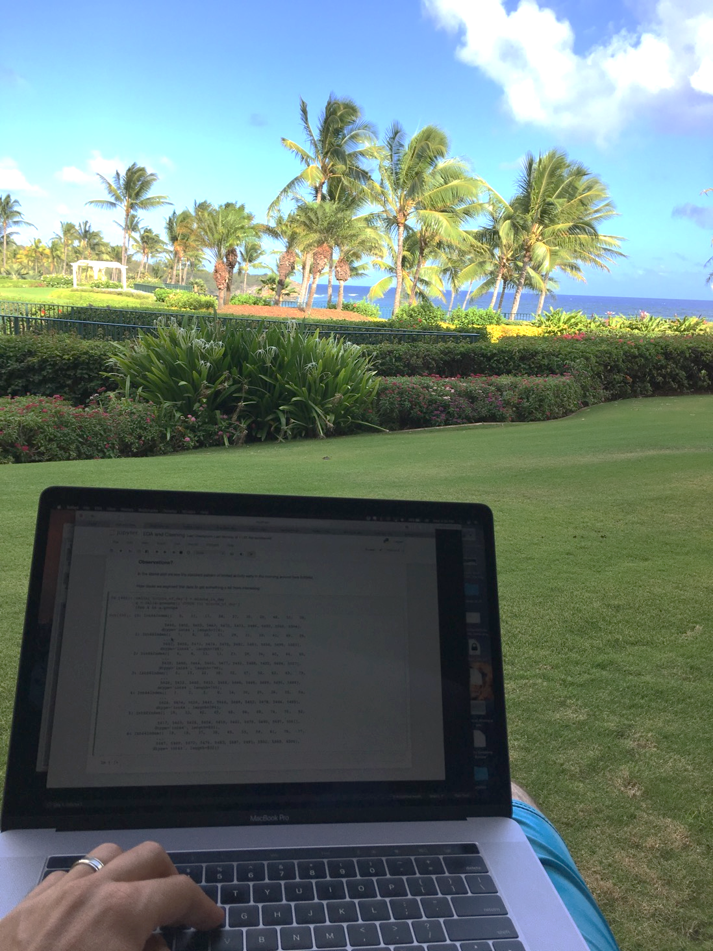
Quick Break
Scope:
Do you have a full picture?

Slide 41
Berkeley Police Data Demo

Slide 42
Berkeley Police Public Datasets
Question: For this analysis we will not begin with a detailed question but instead a rough goal of understanding Police activity.
Examine Two Data Sets:
Call data
Stop data
Today we will work through the basic process of data loading, some preliminary cleaning, and exploratory data analysis.

Slide 43
Call Data Description
Data pulled from Public Safety Server using data created for Berkeley’s Crime View Community page. Displays incidents reported for the last 180 days along with time, date, day of week and block level location information.
The dataset reflects crimes as they have been reported to the BPD based on preliminary information supplied by the reporting parties. Preliminary crime classifications may change based on follow-up investigations. Not all calls for police service are included (e.g. Animal Bite). The information provided on this site is intended for use by the community to enhance their awareness of crimes occurring in their neighborhoods and the entire City. The data should not be used for in-depth crime analysis as the initial information is subject to change.

Slide 44
Stops Data Description
This data was extracted from the Department’s Public Safety Server and covers the data beginning January 26, 2015. On January 26, 2015 the department began collecting data pursuant to General Order B-4 (issued December 31, 2014). Under that order, officers were required to provide certain data after making all vehicle detentions (including bicycles) and pedestrian detentions (up to five persons). This data set lists stops by police in the categories of traffic, suspicious vehicle, pedestrian and bicycle stops. Incident number, date and time, location and disposition codes are also listed in this data.
Address data has been changed from a specific address, where applicable, and listed as the block where the incident occurred. Disposition codes were entered by officers who made the stop. These codes included the person(s) race, gender, age (range), reason for the stop, enforcement action taken, and whether or not a search was conducted.

Slide 45
Visualizing Univariate Relationships
Quantitative Data
Histograms, Box Plots, Rug Plots, Smoothed Interpolations (KDE – Kernel Density Estimators)
Look for spread, shape, modes, outliers, unreasonable values …
Nominal & Ordinal Data
Bar plots (sorted by frequency or oridinal dimension)
Look for skew, frequent and rare categories, or invalid categories
Consider grouping categories and repeating analysis

Slide 46
Histograms, Rug Plots, and KDE Interpolation
Describes distribution of data – relative prevalence of values
Histogram
relative frequency of values in bins (ranges)
Tradeoff of bin sizes
Rug Plot
Shows the actual data locations
Smoothed density estimator
Tradeoff of “bandwidth” parameter (more on this later)
Main Mode
Smoothed Density Estimator
Second Mode
Skew Right
Histogram
Outliers
Gap
Rug

Slide 47
Box Charts
Useful for summarizing distributions and comparing multiple distributions
Comparison of Restaurant Bills
Interquartile Range
(IQR)
Upper Quartile
Outliers
Lower Quartile
Median
Wiskers

Slide 48
Bar Charts
Used to compare nominal and ordinal data.
Consider sorting by category or frequency

Slide 49
Bar Charts
Used to compare nominal and ordinal data.
Consider sorting by category or frequency
Titanic
Passenger
Manifest
Class
Sex
Survived

Slide 50
Visualizing Multivariate Relationships
Conditioning on a range of values (e.g., ages in groups) and construct side by side box-plots or bar charts
Comparison of Restaurant Bills
Titanic Survivors

Slide 51
Visualizing Multivariate Relationships
Scatter Plots: try plotting variables against each other
Try to linearize relationships (eg., logs, exponents, square-roots)
More on transformations when we return to visualizations
Conditioning on a range of values (e.g., ages in groups) and construct side by side box-plots or bar charts

Slide 52
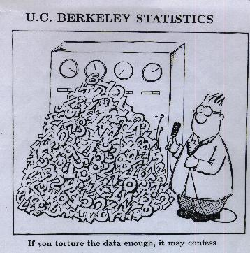
Caution about EDA
With enough data, if you look hard enough you will find something “interesting”
Important to differentiate inferential conclusions about world from exploratory analysis of data

